Slide 1
Large-Scale and Multi-Structured Databases Project Design PixelIndex
Ceccanti Lorenzo
Corsi Cristiano
Mulé Niccolò

Slide 2
Application Highlights
The application is useful for:
Manage your game collection:
Keeping track of your videogame library and add new games with ease
Wishlist:
Add games to your wishlist to keep track to the titles you want to play next filtering by platform, genre or release date
Hall of fame:
Track your trophies and achievements
Join the gaming community:
Connect with other players, share rating and reviews and follow their activities

Slide 3
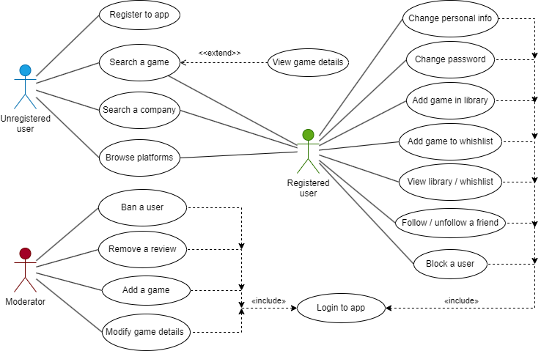
Actors and main supported functionalities

Slide 4
Dataset Description
Source:
Description:
Volume:
Variety:
Velocity/Variability:

Slide 5
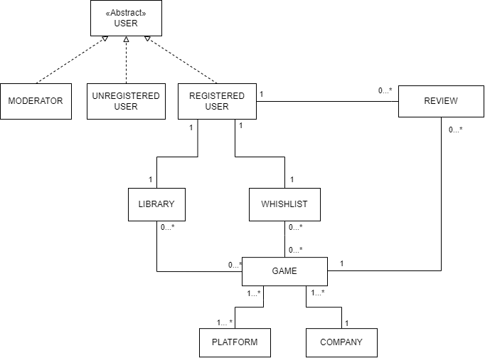
Preliminary UML Class Diagram

Slide 6
Requirements and Entities handled by Document DB
Entities involved:
User
Game
Review
Library
Wishlist
Platform
Company
Main requirements:
Seeing the most added in library games during the current year for each specific platform in order to display them into the "Highlighted" section of the application
Show the "Not recommended" reviews for the games you have put into the wishlist
The user can view the percentage distribution of games played, grouped by genre selecting a time period.

Slide 7
Requirements and Entities handled by Graph DB
Entities involved:
User
Game
User
:ADD_TO_LIBRARY
Game
:FOLLOW
Main requirements:
A registered user is suggested with the people he/she might know
A registered user is suggested with the added to library by his/her friends (more popular games first)
Rank the user according to the number of connections with other user and with the number of games they added.

Slide 8



Software Architecture Preliminary Idea
The front-end will be offered through a Command Line Interface
DBMSs:
Programming languages: Java w/ Maven for handling dependecies (mongodb-driver-sync, neo4j-java-driver) and Python for Web Scraping part (requests & Beautifoul Soup 4).
Data & Analytics Visualization:

